Slide 1
Recommender System for Ingredients Contractor
Data Science Capstone Project

Slide 2
The Business Problem
Problem Description:
Taking the example of a groceries contractor in one of the boroughs of Toronto (Scarborough)
The contractor provides many different places such as: Different types of Coffee shops, Restaurants, Brewery and Café, Bakery with fresh and high quality ingredients
He intends to construct a warehouse to store all the ingredients he buys from farmers in Scarborough, such that he can provide ingredients to even more customers

Slide 3
The Business Problem
Problem Description:
However, it is difficult to determine where should the contractor set up his warehouse at because if the warehouse is located near to those famous restaurants, then the ingredients can be delivered to the restaurant early and in time before the restaurant opens in the morning. Hence allowing the contractor will gain more reputation as a reliable contractor and possibly gain more customers in the future and thus improving his earnings
On the other hand, if the contractor set up his warehouse in nearer the farmers, he may not be able to deliver the ingredients to the restaurants as early

Slide 4
The Business Problem
Problem Description:
In addition to the above example, the question of which neighbourhood in Scarborough is the be a best location for the contractor to set up the warehouse in should be considered as well
Hence, finding the right neighbourhood for the contractor to set up his warehouse is the main objective of this project
This is done my coming up with a recommender system which will produce a sorted list of neighbourhoods in which the first element of the list will be the best suggested neighbourhood, allowing the contractor to determine the best location to set up his warehouse

Slide 5
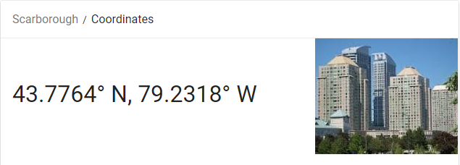
Data Required
1) We will need geo-locational information about Scarborough and the neighbourhoods in that Scarborough. Thus, the latitude and longitude numbers of Scarborough are required for locating it on the map. This will be provided by the contractor. The Postal Codes that fall into Scarborough are required as well. The Postal Codes will then by used to find the neighbourhoods in Scarborough.

Slide 6
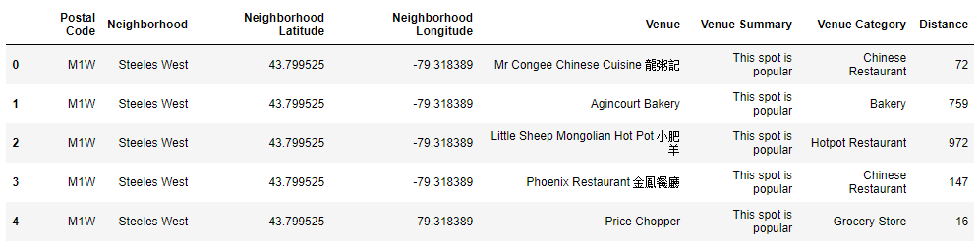
Data required
2) We will need data about different venues in different neighborhoods of that specific borough. In order to gain that information we will use "Foursquare" locational information. A typical request from Foursquare will provide us with the following information:

Slide 7
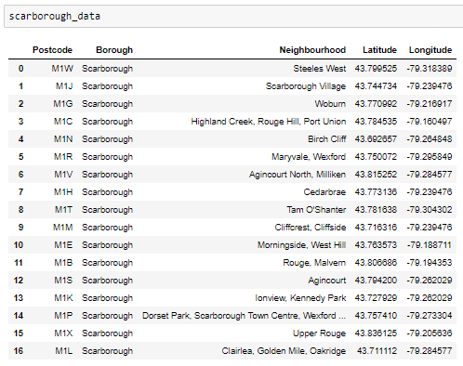
Part 1: Identifying Postal Codes (and then Neighborhoods) in "Scarborough"

Slide 8
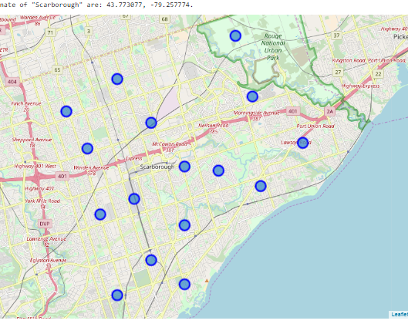
Part 1: Identifying Postal Codes (and then Neighborhoods) in "Scarborough"

Slide 9
Part 2: Connecting to Foursquare and Retrieving Locational Data for Each Venue in Every Neighborhood
After finding the list of neighbourhoods, we connect to the Foursquare API to gather information about venues inside each neighbourhood.
For each neighbourhood, radius is set to 1000 meter → This means that Foursquare will to find venues that are at most 1000 meter away from the centre of the neighbourhood is selected in Foursquare

Slide 10
Part 3: Processing the Retrieved Data and Creating a Data Frame for All the Venues inside the Scarborough
When all the data is retrieved, the raw data will be processed to according to our desirable features for each venue
The main feature that is considered is the category of the venue because it is the key feature that determines whether the location of warehouse is successful.
Then, the column "Venue's Category" will be One-hot encoded, resulting in different venues having different feature-columns.
Next, all the restaurant columns will be combined to form a single column "Total Restaurants"
All the food joint columns will also be combined to form a single column "Total Joints".

Slide 11
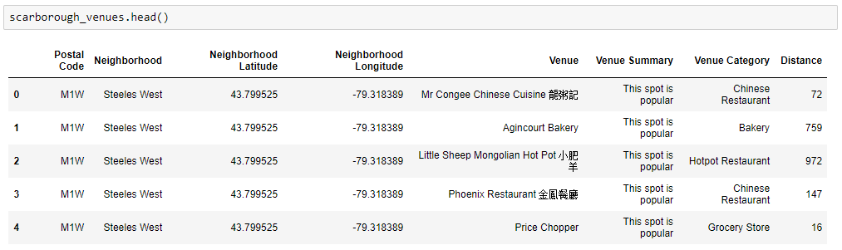
Part 3: Processing the Retrieved Data and Creating a Data Frame for All the Venues inside the Scarborough

Slide 12
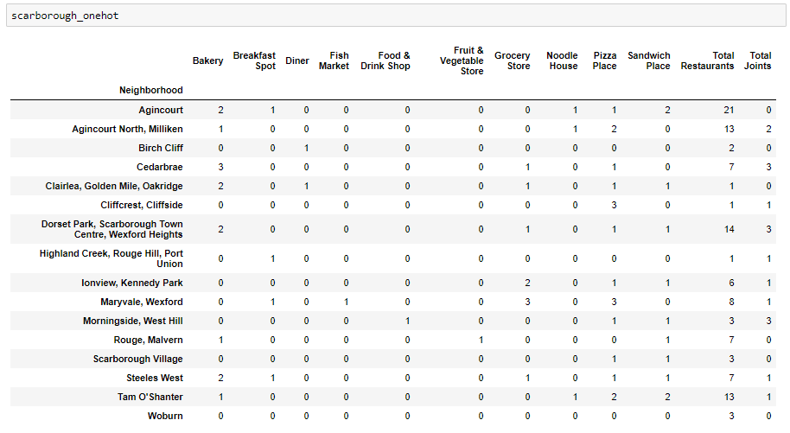
Now, the dataset is fully ready to be used for analysis

Slide 13
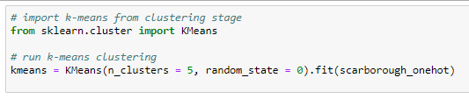
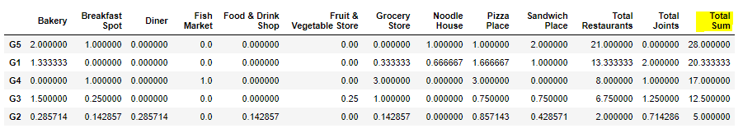
Part 4: Applying one of Machine Learning Techniques (K-Means Clustering)

Slide 14
Decision Making and Reporting Results
I will focus on the centres of the clusters and compare them using the "Total Restaurants" and "Total Joints" columns.
The group which its centre has the highest "Total Sum" will be our best recommendation to the contractor.
(Note: Total Sum = Total Restaurants + Total Joints + Other Venues)

Slide 15
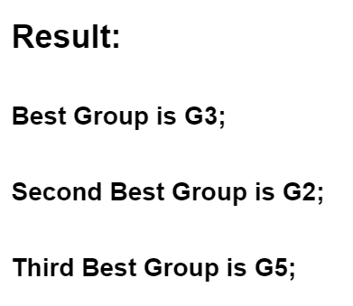
Decision Making and Reporting Results

Slide 16
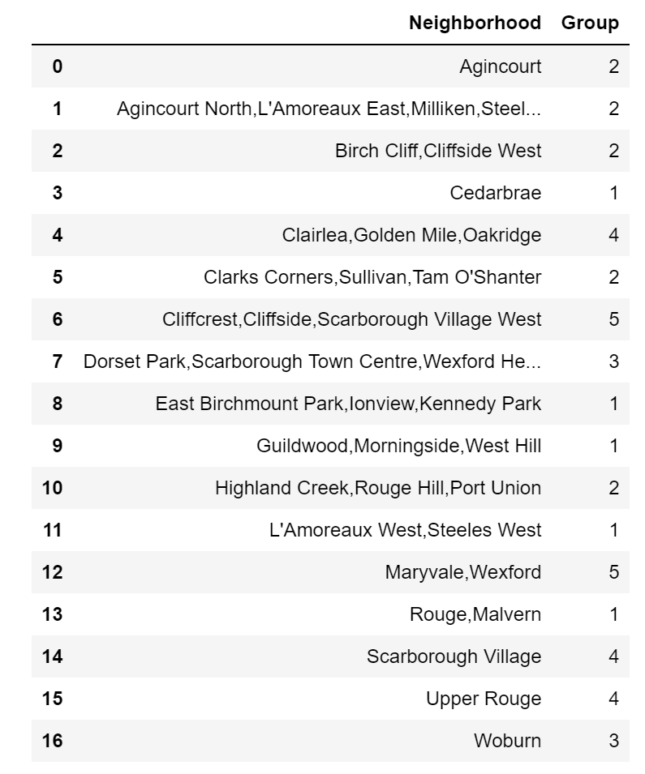
Decision Making and Reporting Results

Slide 17
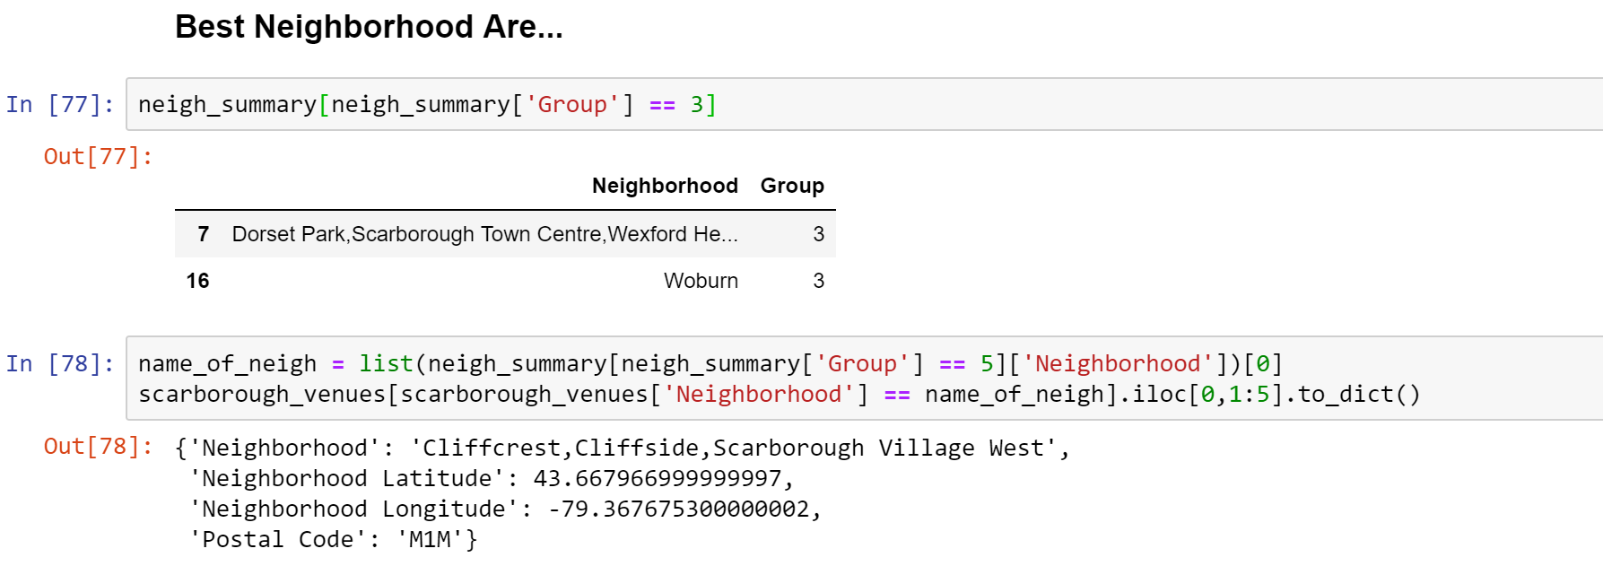
Decision Making and Reporting Results

Slide 18

By: TJQ

